Slide 1



Recommendation Engine On Career Transition

Slide 2


Team Mentors
Mr. Sharath Manikonda
Director : Innodatatics
https://www.linkedin.com/in/sharat-chandra
Aniket Annam
Project Mentor
https://www.linkedin.com/in/aniket-annam-560956166
Thank you very much Mr. Sharath Manikonda Sir for offering your assistance on this project i.e. to build Recommendation System. It is helpful to have someone who has had experience of so many years to offer us guidance and direction. And special Thanks to Aniket Annam for their guidance throughout the project.

Slide 3






Team Members
Akash Tajane
https://www.linkedin.com/in/akash-tajane-01a2841ba
Satish
https://www.linkedin.com/in/satish-sathanandam-04711451/
Shaheer PV
https://www.linkedin.com/in/shaheer-p-v-53086821b/
Tejaswa Verma
https://www.linkedin.com/in/tejaswa-verma-973593208
Aditya chaluvadi
https://www.linkedin.com/in/aditya-chaluvadi-7603581b7
Abhishek Nayak
https://www.linkedin.com/in/abhishek-nayak-6a5790109/

Slide 4






Team Members
Poushali Nag
https://www.linkedin.com/in/poushali-nag1998
Srikanth Dasari
https://www.linkedin.com/in/srikanth-dasari-001a8b1ab
Mohd Amer Hussain
https://www.linkedin.com/in/muhammed-amer-hussain-91179821a
Divya Polana
https://www.linkedin.com/in/divya-polana-46042621b
Anant Singh
www.linkedin.com/in/anant-singh-b73a6777
S. Kanimozhi https://www.linkedin.com/in/kanimozhi-senathipathi-7b53361b6

Slide 5





Team Members
Swapnil Karade
https://www.linkedin.com/in/swapnil-karade-319b63179
Sanket Sarpe https://www.linkedin.com/in/sanketsarpe
Mohammad Yakub
https://www.linkedin.com/in/mohammad-yakub-71a6721b7
Rishy Kumar https://www.linkedin.com/in/rishy-kusuma-7842a3198
Sanket Pawar
https://www.linkedin.com/in/sanket-pawar-b592a421b

Slide 6

Content
Project Overview and Scope
Literature Survey
Objectives and Constraints
Technical Stacks
Project Architecture
Data Collection and Description
Data Understanding
Model Selection and Building
Deployment

Slide 7
Project Overview and Scope
OVERVIEW:
The project aims to recommend career paths to freshers through the Recommendation system
We see freshers find it confusing to choose their future path so this recommendation system will help them choose their proper future today.
After analyzing the pattern from the data, the project will recommend the best career path to the fresher.
SCOPE:
The recommendation system based selection of career path can play a vital role to reduce stress for selecting the appropriate path for an individual.
Also it can help freshers to know in which field they can excel according to their skills and interests.

Slide 8


Objectives & Constraints
Objectives
Constraints
To minimize career dilemma among fresh graduates
regarding future job or higher studies prospects.
Frequent sector change among professionals.
Scalability problem (model is not aware of very lesser known jobs or sectors of higher study)

Slide 9




Technical Stacks
Language :
We used Python as a Programming Language . Because Python is a high-level programming language that has English-like syntax. This makes it easier to read and understand the code
IDE :
Spyder is an open-source cross-platform integrated development environment for scientific programming in the Python language
The Jupyter Notebook is an open-source web application that allows data scientists to create and share documents that integrate live code, equations, computational output, visualizations, and other multimedia resources, along with explanatory text in a single document.
Colab is a free Jupyter notebook environment that runs entirely in the cloud. Most importantly, it does not require a setup and the notebooks that you create can be simultaneously edited by your team members - just the way you edit documents in Google Docs. Colab supports many popular machine learning libraries which can be easily loaded in your notebook.

Slide 10


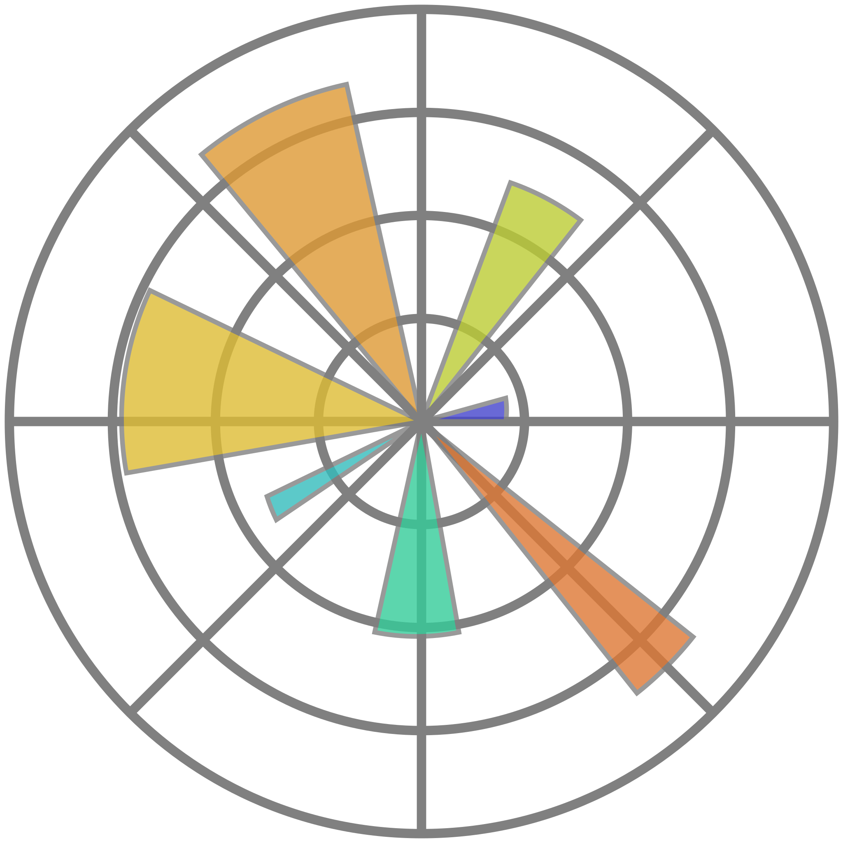


Technical Stacks
Libraries :
NumPy can be used to perform a wide variety of mathematical operations on arrays
Pandas is mainly used for data analysis and associated manipulation of tabular data in Data Frames. Pandas allows importing data from various file formats such as csv, Microsoft Excel.
Matplotlib is a plotting library for the Python programming language
Scikit-learn is probably the most useful library for machine learning in Python. The sklearn library contains a lot of efficient tools for machine learning and statistical modeling including classification, regression, clustering and dimensionality reduction
SciPy is a free and open-source Python library used for scientific computing and technical computing.

Slide 11



Technical Stacks
Web Framework :
Flask allows you to build a web application by providing tools, libraries, and technologies. This web application will be a web page, a wiki, or a big web-based calendar application or commercial website.
HTML (HyperText Markup Language) is the code that is used to structure a web page and its content. For example, content could be structured within a set of paragraphs, a list of bulleted points, or using images and data tables.
Heroku is a container-based cloud Platform as a Service (PaaS). Developers use Heroku to deploy, manage, and scale modern apps.

Slide 12
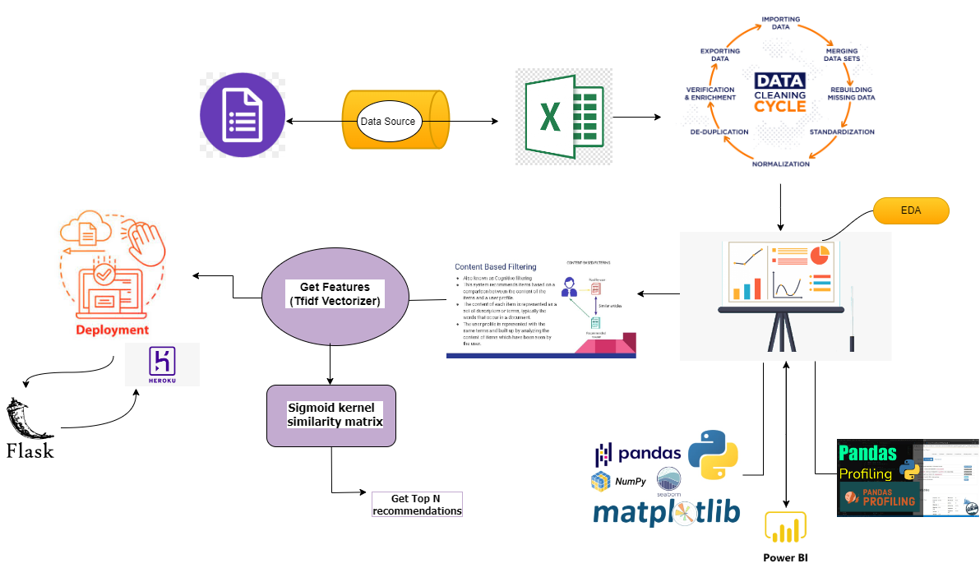
Project Architecture

Slide 13

Data Collection
Data collection is defined as the procedure of collecting, measuring and analyzing accurate insights for research using standard validated techniques
Data is collected through primary sources like surveys
We created a Google form based on our requirement
Source of Data
Surveys

Slide 14
Data Understanding
Attribute Information:
Name: name of the participant.
Gender: gender of the participant. Nominal.
UG stream: participants ug stream Nominal.
UG specialization: UG specialization subject.
Interests: Areas they are interested in.
Skills: skills they are good at.
UG percentage/CGPA: Their CGPA/percentage obtained in UG.
Certification: If they did any certifications(YES/NO).Nominal
Certification Title : if certification is yes, then title of the certification.
Working: Are they working or not(YES/NO).Nominal
Job title: If they are working then what is their job title.
Post graduation: If they done any PG, if yes what is their post graduation.

Slide 15
Data Understanding
In this model the data is analysed when the new details are entered and the model match it to the dataset and recommends the jobs on the basis of results we got from sigmoid function.
Data Dictionary
Name of the Feature | Description | Nature | Type of Variable
Skills | Skills set of an individual | Qualitative | Categorical
Interests | Fields in which an individual have interest | Qualitative | Categorical
Under Graduation | Stream from which graduation is done | Qualitative | Categorical
UG Specialization | Special subject in UG | Qualitative | Categorical

Slide 16

Data Preparation
Data Cleaning
Outlier Analysis
Data Pre-processing
NLP
TF-IDF Vectorizer
Structured into Pandas DataFrame

Slide 17
EDA
MARKET ANALYSIS
Data cleaning
Packages
Visualization
Gathering data from sources and drawing insights from it
Data cleaning involved cleaning of entries. Making manual entries to one particular key word.
E.g.. B.tech from btech
After cleaning we try to visualize the data set.
Libraries used are pandas, NumPy, seaborn
Drawn insights from data. Like most opted course by students.

Slide 18
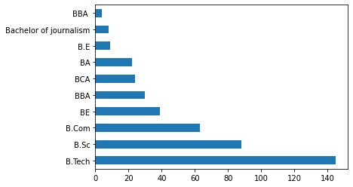
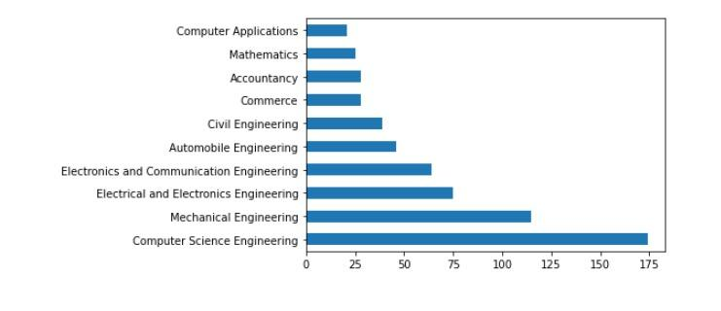
Univariate Analysis
This is Bar Plot for the UG course done by the people. Clearly, B Tech is the favourite choice for under_graduation studies followed by B.Sc. and B.Com .
This is Bar Plot for the UG specialization done by the people. Clearly, Computer Science Engineering is the favourite choice.

Slide 19
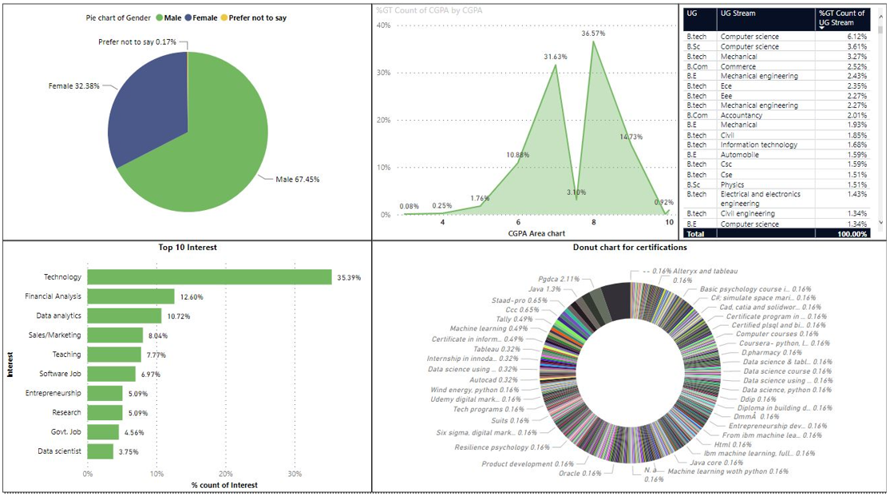
Univariate Analysis

Slide 20
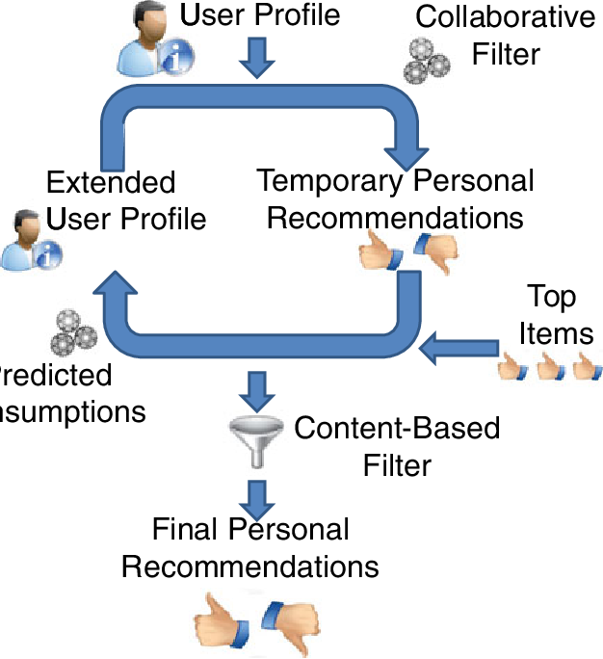
Model Selection
Content Based Filtering
Content based filtering is about extracting knowledge from the content.
In a content-based Recommender system, keywords are used to describe the items and a person’s profile is built to indicate the type of choices the person makes. In other words, these algorithms try to recommend career choices that are people having similar history have made.

Slide 21
TFIDF-Vectorizer
Stands for term frequency and inverse document frequency
Convert a collection of documents to a matrix of TF-IDF features.
tf is the number of times a term appears in a particular document. So it’s specific to a document. A few of the ways to calculate tf is given below:-
tf(t) = No. of times term ‘t’ occurs in a document
OR
tf(t) = (No. of times term ‘t’ occurs in a document) / (No. Of terms in a document)
OR
tf(t) = (No. of times term ‘t’ occurs in a document) / (Frequency of most common term in a document)
sklearn uses the first one i:e No. Of times a term ‘t’ appears in a document
idf is a measure of how common or rare a term is across the entire corpus of documents. So the point to note is that it’s common to all the documents. If the word is common and appears in many documents, the idf value (normalized) will approach 0 or else approach 1 if it’s rare. A few of the ways we can calculate idf value for a term is given below
idf (t) =1 + log _{e} [ n / df(t) ]

Slide 22
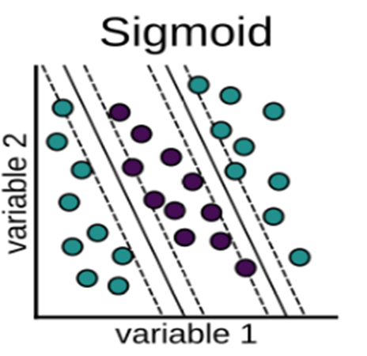
Sigmoid Kernel Metrics
The sklearn.metrics.pairwise submodule implements utilities to evaluate pairwise distances or affinity of sets of samples.
Kernels are measures of similarity, i.e. s(a, b) > s(a, c) if objects a and b are considered “more similar” than objects a and c.
The function sigmoid_kernel computes the sigmoid kernel between two vectors.
The sigmoid kernel is also known as hyperbolic tangent.
It is defined as:
K(X,Y)=tanh(γ⋅X^TY+r)
•X, Y are the input vectors
•γ is known as slope
• r is known as the intercept

Slide 23
Coding-Steps Followed
1. import Necessary libraries.
2. import Dataset(df)
3. EDA and Visualization by Pandas Profiling
4. Data Preprocessing
4.1 Dealing with Null values.
4.2 Cleaning the Data
4.3 Filter the initial Dataset (df) into Job Data set, Masters dataset and Students Data set by following codes.
dfj=df.loc[df.wrk =='Yes'].iloc[:,[1,2,3,4,9]]
dfm=df.loc[(df.wrk =='No') & (df['mas'] !="" )].iloc[:,[1,2,3,4,10]]
dfs=df.loc[(df.wrk =='No') & (df.mas =="" )].iloc[:,[1,2,3,4]]

Slide 24
5. Model Building by Content based similarity
5.1 input the new student details to df dataset through a dictionary( append operation on df dataset)
5.2 Now the last element of df data set will be our new student input.
The code will be, df.iloc[[-1],:]
5.3 by using NLP clean the data
5.4 TF-IDF vectorizer for creating sparse matrix and converted into pandas dataframe df_tfidf
5.5 Splitting the dataframe df_tfidf into job,masters and students dataset
df_tfidf_j=df_tfidf.loc[lst_j,:]
df_tfidf_m=df_tfidf.loc[lst_m,:]
df_tfidf_s=df_tfidf.loc[lst_s,:]
df_tfidf_for_new_user =df_tfidf_s.iloc[[-1],:]

Slide 25
5.6 Selecting job/masters dataset as per new student requirement
if str(which)=='j' or str(which)=='J':
y=df_tfidf_j
else:
y=df_tfidf_m
5.7 Sigmoid similarity Checking
sig_sim_matrix=sigmoid_kernel(df_tfidf_for_new_user ,y)
5.8 Finally Recommendation will be given based on Sigmoid score .

Slide 26



Deployment Strategy
In the Deployment, we have used the following tools:
Python
A tool used for Manipulation of data and model deployment using different libraries and Modules like Pandas, Flask , stats models.
Python Flask is an open-source python library that makes it easy to create custom web apps for machine learning and data science. It is classified as a micro-framework because it does not require particular tools or libraries. it has no database abstraction layer, form validation, or any other components where pre-existing third party libraries provide common functions.
Python Flask
HTML (hyper text markup language) is use for making structure of the website to take inputs manually from the user.
CSS (Cascading Style sheet) is used for describing the presentation of the html document or styling the html structure to make it look good.
Html & CSS

Slide 27


Deployment Strategy
Heroku is a container-based cloud Platform as a Service (PaaS). Developers use Heroku to deploy, manage, and scale modern apps.
Heroku
Heroku integrates with GitHub to make it easy to deploy code living on GitHub to apps running on Heroku. When GitHub integration is configured for the Heroku app, Heroku can automatically build and release( is the build is successful) pushes to specified GitHub Repository
GitHub

Slide 28
HTML and CSS
For designing the user interface is mainly depends on Html and CSS
Html stands for Hyper Text Markup Language and CSS stands for Cascading Style Sheets
Html page is made of tags that specify the structure of the web page
This is order to represent the tags in html page
<html>
<head>
……..
</head>
<body>
………
</body>
</html>
Every web designing technology mainly depends on Html
CSS gives different styles to the web page
CSS has different different properties like color, font, images and size etc.

Slide 29
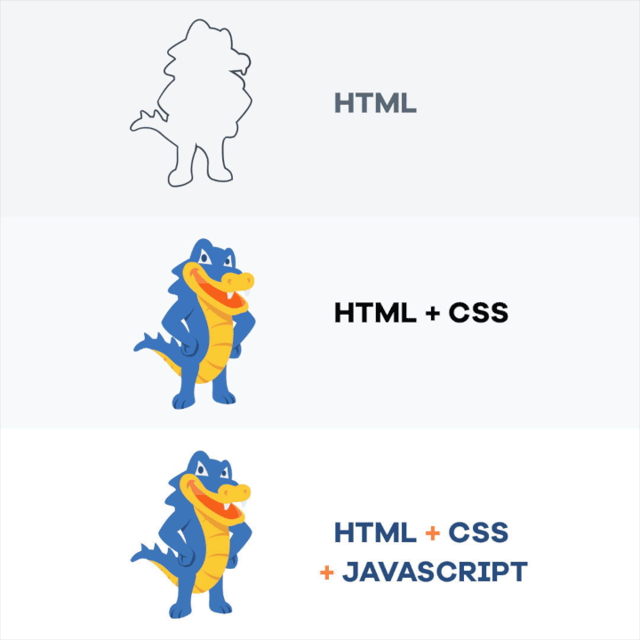

Slide 30
Deployment using Heroku and Github
Python Flask API is used for web deployment of ML model
For deploying python flask in Heroku using Github requires following files
Main python file
Python ML model file
HTML
Excel data set for ML model
Requirement file
Procfile
Once files are copied in Github,Heroku can be used to build and deploy model for public access.
Python ML Model
HTML
Excel Data Set
Main

Slide 31

Deployment View
http://career-recommendation-systems.herokuapp.com/

Slide 32
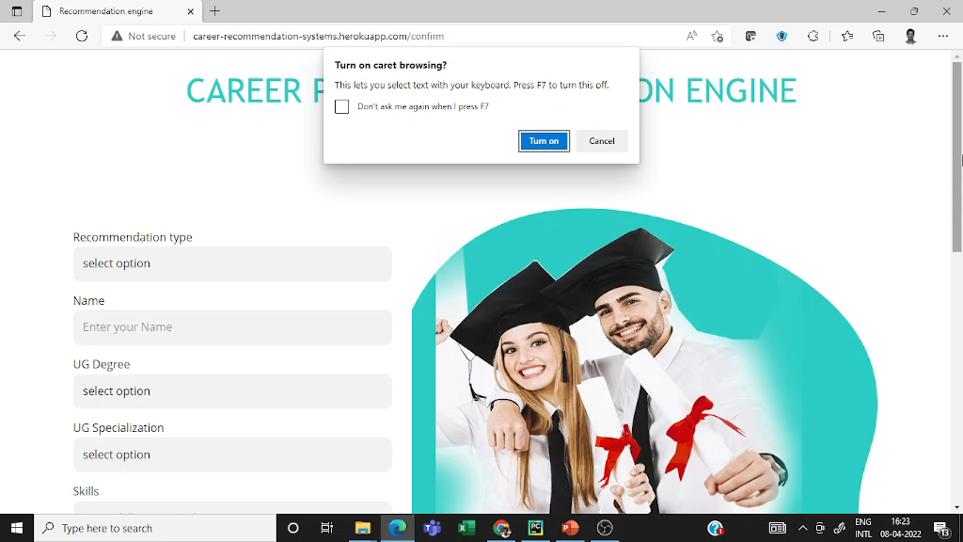
Deployment Video

Slide 33
Conclusion
The Model Recommends the Best career path to fresher through Recommendation system.
The main features affecting the Recommendations are UG, UG Specialization, Interest, and skills.

Slide 34
Reference
1 | As surveyed by Bharat Pateet al.- A Career Path Recommendation Framework | Proposed CaPaR, a Career Path Recommendation framework, which addresses such shortcomings. , the system recommends additional skills to students required for related job openings, as well as learning resources for each skill.
2 | Prof. Vijay Kolekar et al. - Implementation of an Automated Job Recommendation System Based on Candidate Profiles | Designed and implemented a recommendation system for online job hunting. he contrasts user-based and item-based collaborative filtering algorithm to choose a better performed one.
3 | As surveyed by Nguyen Thai-Nghe et al.- Recommender System for Predicting Student Performance | proposed a novel approach which uses recommender system techniques for educational data mining, especially for predicting student performance.

Slide 35
4 | As surveyed by Maryam Fazel-Zarandi al.- Semantic Matchmaking for Job Recruitment: An Ontology-Based Hybrid Approach | The approach uses a deductive model to determine the kind of match between a job seeker and an advertisement, and applies a similarity-based approach to rank applicants.
5 | As surveyed by Waleed M. Al-Adrouset al.- A Framework for Career-Education Hybrid Recommender System using a Selective Path Delta SimRank Algorithm | suggests a general framework for a social network to connect students and experts. The framework depends on a variation of Delta SimRank algorithm. The suggested variation is called Selective Path Delta-SimRank (SPDSR).
6 | As surveyed by Nikolaos D. Almalis et al. - FoDRA - A New Content-Based Job Recommendation Algorithm for Job Seeking and Recruiting | proposed a content-based recommendation approach which extends and updates Minkowski distance in order to address the challenge of matching people and jobs.

Slide 36


